Slide 1
C++ Programming Design
Session #5

Slide 2
#5 Adventures in Functions
Inline functions
Reference variables
How to pass function arguments by reference
Default arguments
Function overloading

Slide 3
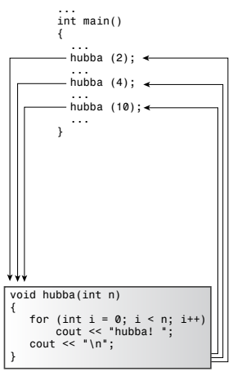
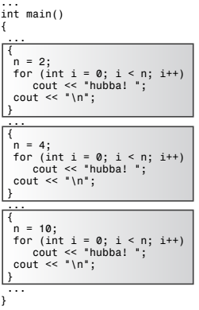
C++ Inline Functions: Speed up
Regular
Inline
inline

Slide 4


C++ Inline Functions: Inline Versus Macros
EXAMPLES:
(1)inline double square(double x) {
return x * x;
}
a = square(5.0);
b = square(4.5 + 7.5);
d = square(c++); //c=5;
(2)#define SQUARE(X) X*X
a = SQUARE(5.0);
b = SQUARE(4.5 + 7.5);
d = SQUARE(c++); //c=5;
$$=$$
$$≠$$

Slide 5


C++ Inline Functions: Inline Versus Macros
EXAMPLES:
(1)inline double square(double x) {
return x * x;
}
a = square(5.0);
b = square(4.5 + 7.5);
d = square(c++); //c=5;
(2)#define SQUARE(X) (X)*(X)
a = SQUARE(5.0);
b = SQUARE(4.5 + 7.5);
d = SQUARE(c++); //c=5;
$$=$$
$$=$$
$$≠$$

Slide 6
Reference Variables
(1)A reference acts as an alias for a previously defined variable.
(2)Initialize a reference variable when you declare it.
(3)A reference cannot be changed after it is initialized.
(4)Definition example:
int rats;
int & rodents = rats;
(5)Reference vs. const pointer
int & rodents = rats;
int * const p=&rates;
int rat; int & rodent; rodent = rat;

Slide 7
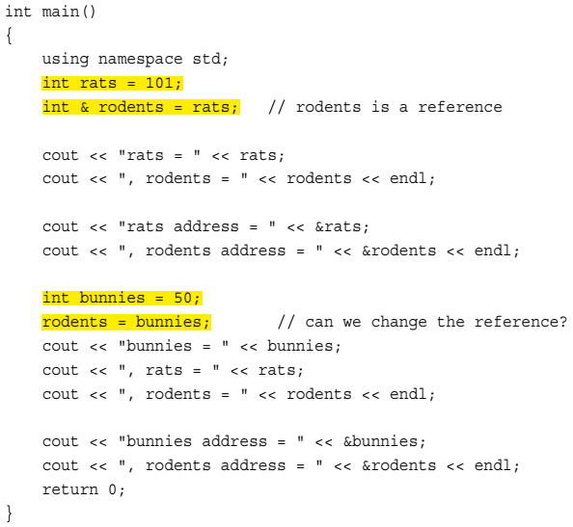
Reference Variables

Slide 8
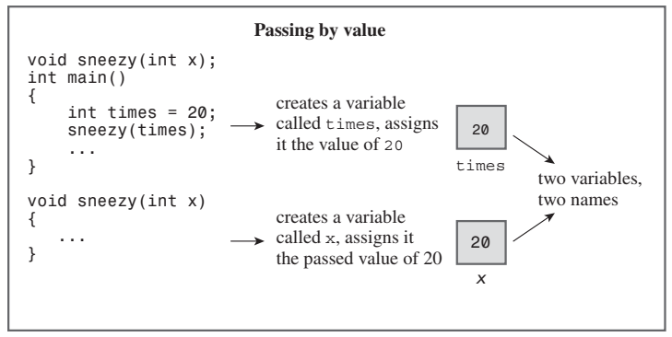
Reference Variables: as Function Parameters

Slide 9
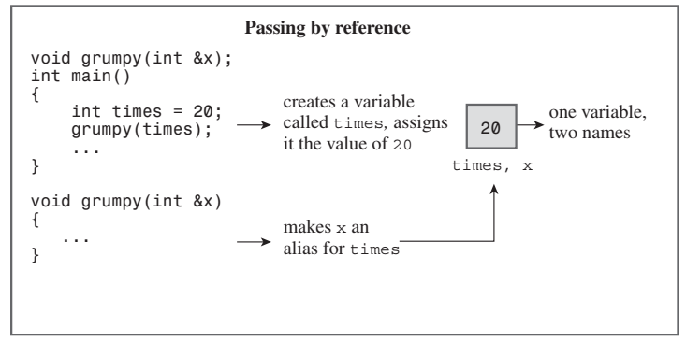
Reference Variables: as Function Parameters

Slide 10
Reference Variables: swap function
void swapv(int a, int b) // use value passing
{ int temp; temp = a; a = b; b = temp; }

Slide 11
Reference Variables: swap function
void swapp(int * p, int * q) // use pointer passing
{
int temp;
temp = *p;
*p = *q;
*q = temp;
}

Slide 12
Reference Variables: swap function
void swapr(int & a, int & b) // use reference passing
{
int temp;
temp = a;
a = b;
b = temp;
}

Slide 13
Reference Variables: as Function Parameters
Two main reasons for using reference arguments:
(1)To allow you to alter a data object in the calling function
(2)To speed up a program by passing a reference instead of an entire data object

Slide 14
Reference Variables: NOTES
(1) What happened for the following codes:
long a = 3, b = 5;
swapr(a, b);
(2)Const reference: Cannot change value by const reference.
void swapr(const int & a, const int & b) ;
int a = 3, b = 5;
swapr(a, b);
//void swapr(int & a, int & b);

Slide 15
Reference Variables: NOTES
(3)Const reference also receiving arguments of literals, expressions and variables of different type.
Example:
void cube(int & a) ;
a) cube(3);
b) int x=1; cube(x+1);
c) double d; cube(d);
Notes:
cube中改变a将无法改变a引用指向的变量

Slide 16
Reference Variables: NOTES
(3)Const reference also receiving arguments of literals, expressions and variables of different type.
Example:
void cube(const int & a) ;
a) cube(3);
b) int x=1; cube(x+1);
c) double d; cube(d);
A temporary variable is generated in argument passing procedure.

Slide 17
Reference Variables: C++11
A second kind of Reference: rvalue reference/rvalue
Declaration: &&
Literals or expressions, …
Examples:
double && rref = std::sqrt(36.00); // not allowed for double &
double j = 15.0;
double && jref = 2.0* j + 18.5; // not allowed for double &
std::cout << rref << '\n'; // display 6.0
std::cout << jref << '\n'; // display 48.5;
Notes:
rvalue右值引用

Slide 18
Reference Variables: lvalue
lvalue and rvalue from assignment statements
lvalue: A data object that can be referenced by address.
For example, a variable, an array element, a structure member, a reference, and a dereferenced pointer are lvalues.
Two kinds of lvalue:
(1) modifiable lvalue: regular variable
(2) non-modifiable lvalue: const variable

Slide 19
Function Default Arguments
A default argument is a value that’s used automatically if you omit the corresponding actual argument from a function call.
Gives you flexibility in how you use a function.
An example:
char * left(const char * str, int n);
left(“abcd”, 1);
left(“abcd”, 3);

Slide 20
Function Default Arguments
A default argument is a value that’s used automatically if you omit the corresponding actual argument from a function call.
Gives you flexibility in how you use a function.
An example:
char * left(const char * str, int n = 1);
left(“abcd”);
left(“abcd”, 3);

Slide 21
Function Default Arguments
When you use a function with an argument list, you must add defaults from right to left.
int harpo(int n, int m = 4, int j = 5); // VALID
int chico(int n, int m = 6, int j); // INVALID
int groucho(int k = 1, int m = 2, int n = 3); // VALID

Slide 22
Function Default Arguments
When you use a function with an argument list, you must add defaults from right to left.
int harpo(int n, int m = 4, int j = 5);
beeps = harpo(2); // same as harpo(2,4,5)
beeps = harpo(1,8); // same as harpo(1,8,5)
beeps = harpo (8,7,6); // no default arguments used
beeps = harpo(3, ,8); // INVALID, doesn't set m to 4

Slide 23
Function Overloading
Function Polymorphism
Function signature:
If two functions use the same number and types of arguments in the same order, they have the same signature.
The argument names and function type don’t matter
C++ enables you to define two functions by the same name, provided that the functions have different signatures.

Slide 24
Function Overloading
Overloaded Function Declarations:
void print(const char * str, int width); // #1
void print(double d, int width); // #2
void print(long l, int width); // #3
void print(int i, int width); // #4
void print(const char *str); // #5
Overloaded Function Callings:
print("Pancakes", 15);
print("Syrup");
print(1999.0, 10);
print(1999, 12);
print(1999L, 15);
// use #1
// use #5
// use #2
// use #4
// use #3

Slide 25
Function Overloading
You might find function overloading fascinating, but you shouldn’t overuse it.
You should reserve function overloading for functions that perform basically the same task but with different forms of data.

Slide 26
Function Overloading: NOTE
void stove(double r0);
void stove(double & r1);

Slide 27
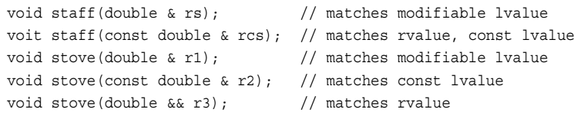
Function Overloading: Reference arguments
Consider the following three function prototypes:
(1)void sink(double & r1); // matches modifiable lvalue
(2)void sank(const double & r2); // matches modifiable or const lvalue, rvalue
(3)void sunk(double && r3); // matches rvalue
How to match when function overloading:

Slide 28
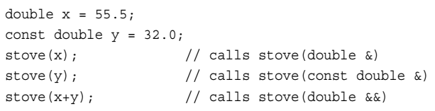
Function Overloading: Reference arguments
How to match when function overloading:
When function calling:

Slide 29
Function Overloading vs. Default Arguments
You might want to check whether you can accomplish the same end by using default arguments.

Slide 30
Function Overloading vs. Default Arguments
Function Overloading
char * left(const char * str, unsigned n); // two arguments
char * left(const char * str); // one argument
Maybe Alternative by Default Argument:
char * left(const char * str, unsigned n=1);

Slide 31
Function Overloading vs. Default Arguments
Ambiguity:
char * left(const char * str, unsigned n=0);
char * left(const char * str);

Slide 32
Programming Exercises
5.1 Write a function that normally takes one argument, the address of a string, and prints that string once. However, if a second, type int, argument is provided and is nonzero, the function should print the string a number of times equal to the number of times that function has been called at that point. (Note that the number of times the string is printed is not equal to the value of the second argument; it is equal to the number of times the function has been called.) Yes, this is a silly function, but it makes you use some of the techniques discussed in this session 5. Use the function in a simple program that demonstrates how the function works. Do you have alternative methods?

Slide 33
Programming Exercises
5.2 The CandyBar structure contains three members. The first member holds the brand name of a candy bar. The second member holds the weight of the candy bar, and the third member holds the number of calories in the candy bar. Write a program that uses a function that takes as arguments a reference to CandyBar, a pointer-to-char, a double, and an int and uses the last three values to set the corresponding members of the structure. The last three arguments should have default values of “Millennium Munch,” 2.85, and 350. Also the program should use a function that takes a reference to a CandyBar as an argument and displays the contents of the structure. Use const where appropriate.

Slide 34
Programming Exercises
5.3 Write two programs with function overloading and default arguments, respectively. Both the programs output maximum value among two or three arguments which are type int and larger than 0.

